Slide 1
Transportation Management Dataset - Level 1
Data Challenge 2021
MIDN 4/C Ballesteros, MIDN 4/C Bartosik, and MIDN 4/C Doherty

Slide 2
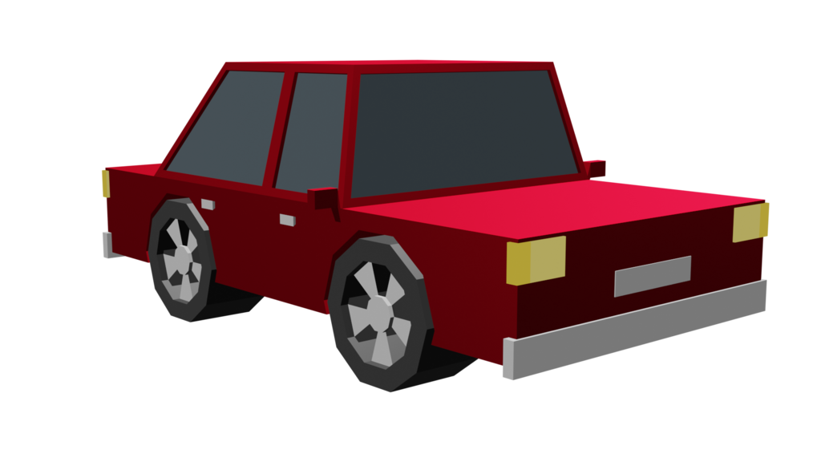
What is VMT?
Vehicle Miles Traveled
Measures total travel for ALL vehicles
We counted
Driving alone
Driving a carpool

Slide 3
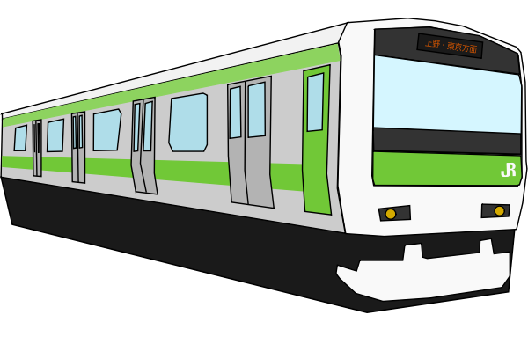
What is NADMS?
Non Auto-Driver Mode Share
Miles measured without adding cars to the road
We counted
Telework/Work from home
Trains
Buses
Walking/Biking

Slide 4
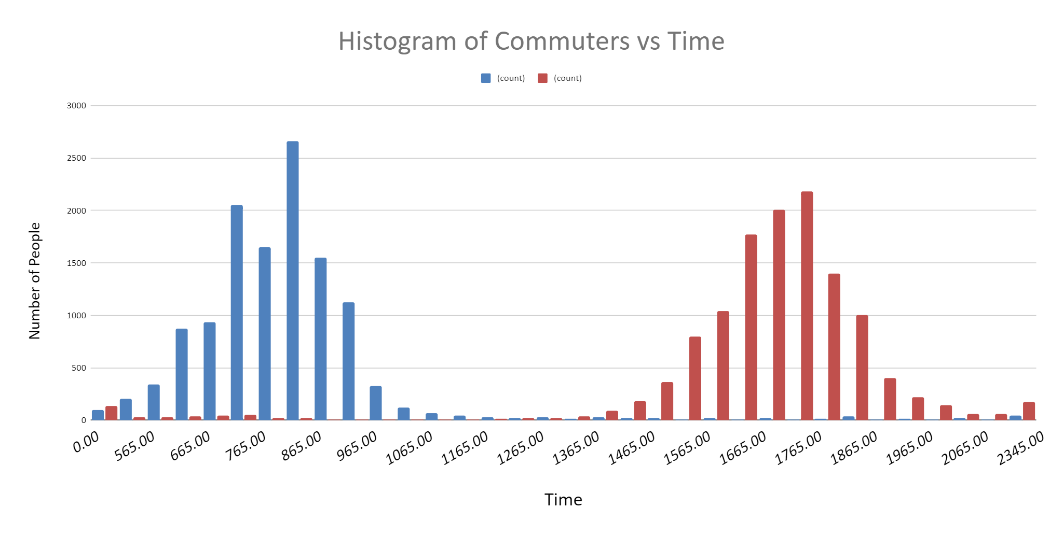
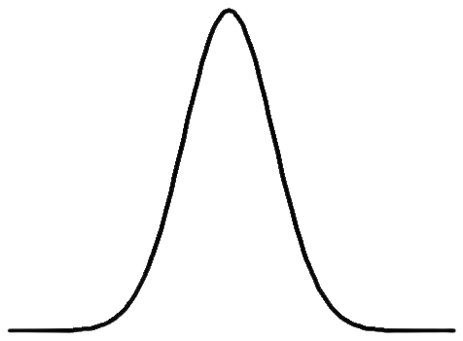
The Commute - By Time
Median Arrival: 0815
Median Departure: 1700

Slide 5
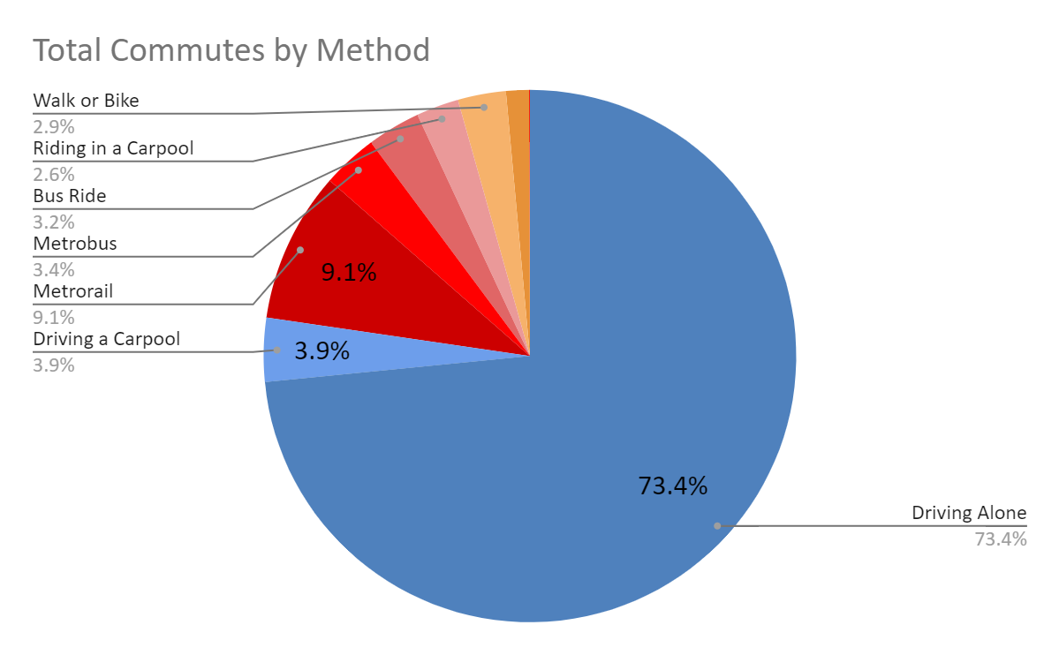
The Commute - By Method
Notes:
Amount of commutes (not miles or people)
Alternative Modes (Red)
VMT (Blue)

Slide 6
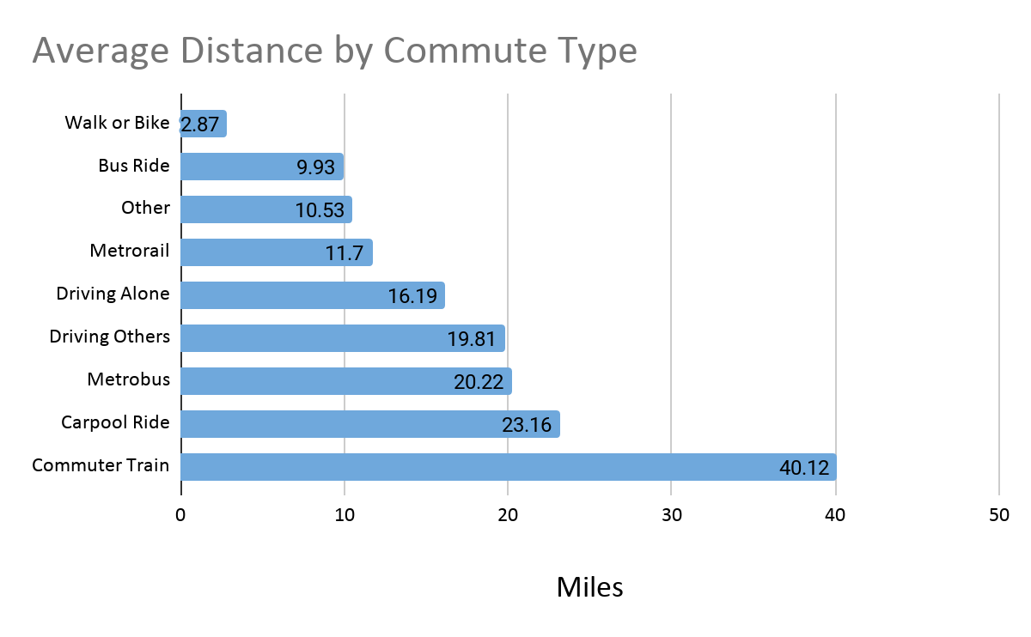
The Commute - By Distance
Notes:
Calculated: Added each commute type distance divided by number of people
Point: People who drive alone have further to go compared to people with access to metrorail, driving alone in the middle. Could easily adapt into another method

Slide 7
The 5 TMD Services
Shady Grove
Montgomery County Employees
Friendship Heights
Silver Spring
Rockville
Notes:
Arbitrarily chose these 5 to use the data from

Slide 8
Question #1, 2: VMT Numbers
What is the actual number of miles traveled on the roads by all vehicles in one week?
If every individual drove alone to work, how many total miles would their vehicles travel?
TMD | Real VMT (Weekly) | MAX VMT (Weekly)
Shady Grove | 234,255 | 289,809
Montgomery County Employees | 184,627 | 231,490
Friendship Heights | 76,248 | 126,095
Silver Spring | 71,186 | 101,463
Rockville | 3,684 | 6,066
Notes:
Left Column: Current activity on road
Right Column: Everyone traveling on their own
How Close to worse case scenario comparisons, each sector has varying populations

Slide 9
Question #3: How can we show savings on VMT?
Actual VMT
(1 - )*100 = % Miles Saved
Max VMT

Slide 10
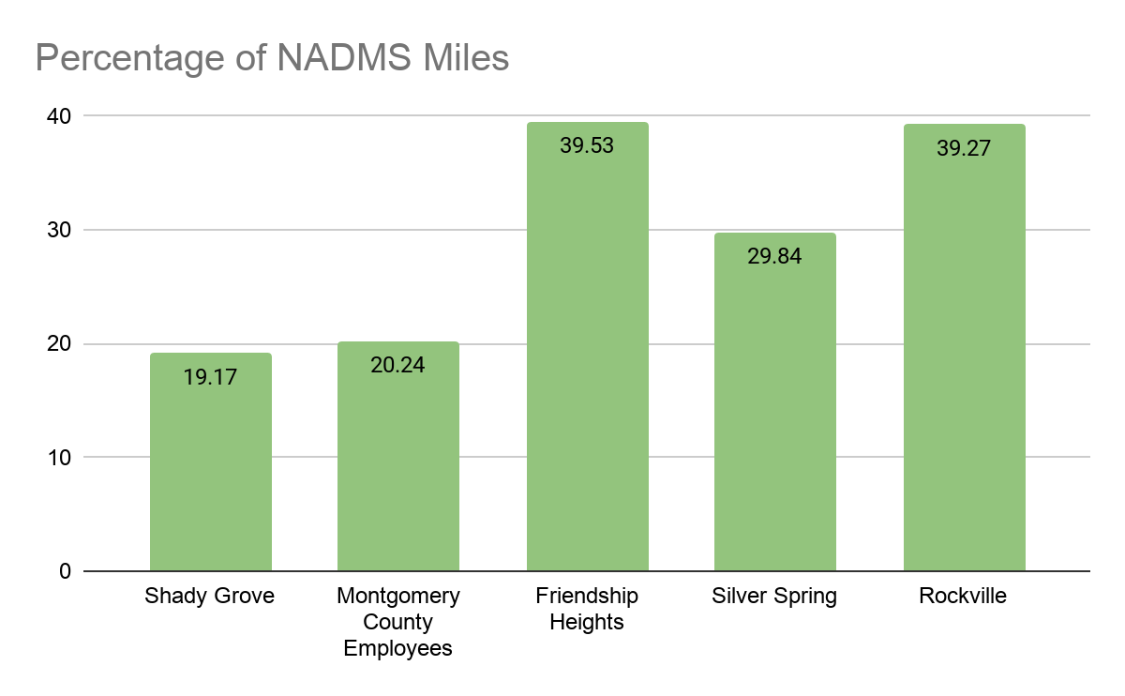
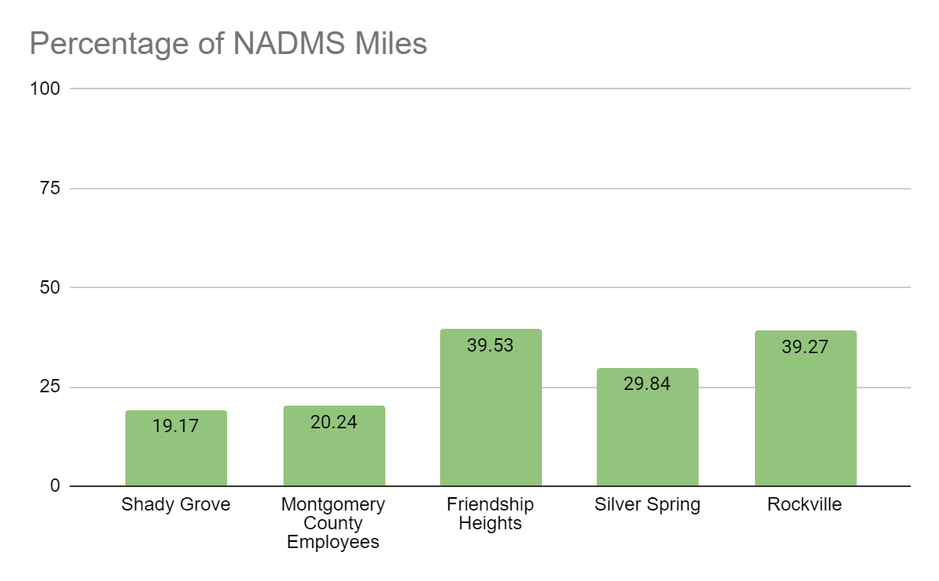
Notes:
Current percentage of people who are using alternative travel modes
Percentages are still low

Slide 11
Future Solutions
If _____ % of drives were replaced with alternate transit...
1% | 5% | 10%
6,433 miles | 32,164 miles | 64,327 miles
… thousands of miles could be saved each week!
Notes:
Replacing commutes not drivers

Slide 12
How can we encourage other travel?
1300 people were offered NO incentive for NADMS
Employees accepted ~42% of offered incentives
By offering incentives to everyone, we could expect 7100 miles saved

